Slide 1

Member Benefits Presentation
Unlock the Strength of the Chamber Network
Place your Chamber’s logo here!

Slide 2





Member Benefits
Unlock the Strength of the Chamber Network
Access Canada’s Largest Business Network
Receive exclusive Members Only benefits
Streamline your business and business cards
Place your Chamber’s logo here!

Slide 3
Member Benefits
Your Membership can save you money, with access to exclusive member rates on:
Employee Benefits Plan
Online Payroll and Human Resources Programs
Hotels and Car Rentals Worldwide
Electronic Payment Processing and Merchant Services
Fuel Discount Programs
Business Supplies
Online Marketing Management
Experiential Learning/Project Support Program
And More!

Slide 4


















Member Benefits
Featured Member Benefit Programs
NEW Member Benefit Programs

Slide 5
Employee Benefits
Member Benefits
Logo Here
Canada’s #1 Plan for Group Benefits. Customize an Employee Benefits that matches your needs.
  Canada’s #1 Plan for Employee Benefits
  Flexibility - design an employee benefit plan (medical, dental, etc.) that works for any budget
  No minimum company size, and no industry restrictions
  Guaranteed approval for companies with 3+ employees
  Rate stability at renewal
  Outstanding service; fast, accurate payments
Detailed Brochure Available, please ask your Chamber Representative.

Slide 6
Merchant Solutions
Member Benefits
Logo Here
First Data’s Merchant Solutions help businesses reach more customers by offering fast and secure payment processing options in tandem with a wide selection of devices.
Preferred Member pricing on merchant services, including, credit and debit card transactions
Access to full suite of products:
    Ecommerce, TeleCheck Electronic Cheque Acceptance, First Data Mobile Pay, Wired & Wireless Terminal, Gift Card Solutions
Products tailored to suit business needs helping
business grow
Detailed Brochure Available, please ask your Chamber Representative.

Slide 7

Payroll Solutions
Member Benefits
Logo Here
Payworks’ innovative online solutions for Payroll, Human Resources, and Time and Absence Management increase payroll accuracy and reduce costly errors.
  Features include: direct deposit, automatic government remittances, year-end tax filing/T4s submission and electronic records of employment.
  Dedicated Client Service Representative
  Employee self-service provides easy access for your employees to receive paystubs and T4s
  Exclusive pricing to BC Chamber members through Affinity program.
Detailed Brochure Available, please ask your Chamber Representative.

Slide 8
Merchant Services
Member Benefits
Logo Here
BluePay is partnered with authorized agent Chris Browes from the BC Based Kubera Payments team to provide industry leading payments services and solutions to the BC Chamber Members.
Kubera in partnership with BluePay are able to offer the following solutions:
The widest range of processing partners and POS integration options available
Industry leading preferential processing rates for members
PCI and PA:DSS compliance consulting services
Integration and support management teams
Electronic invoicing and payment
Custom hosted payment form and set-up
Web development services
Local support
Customized dedicating landing pages hosted on the BluePay site for all regional Chambers are available.
Detailed Brochure Available, please ask your Chamber Representative.

Slide 9
Legal Services
Member Benefits
Logo Here
For a small monthly fee, LegalShield drops high hourly rates to offer legal plans that get you 24/7 access to advice and counsel on an unlimited number of personal legal issues from lawyers with an average of 19 years of experience. From wills and estate planning to small business protection and identity theft, LegalShield is a one-stop shop for legal counsel and services.
BC Chamber members get an exclusive discount on the monthly fee, making legal solutions for your personal and business needs that much more affordable.
Plans include: Small Business Plans, Identity Theft Protection, Family Plans and individual Legal Plans. To set this program up, please contact:
  Patricia Lapena
  BC Regional Manager, LegalShield
  (604) 833-3631
  Patricia.legalshield@gmail.com
  www.patricialapena.com
Detailed Brochure Available, please ask your Chamber Representative.

Slide 10
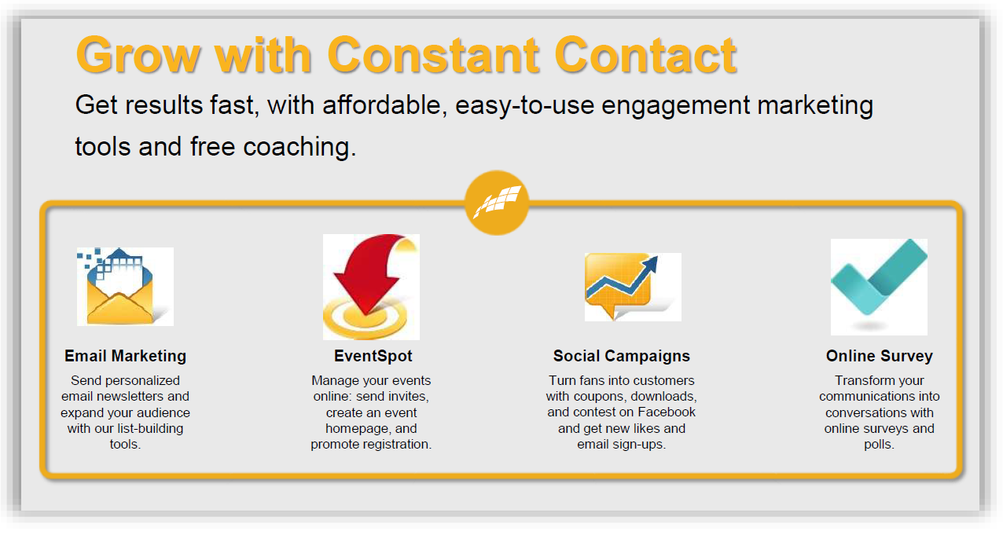
Online Marketing
Member Benefits
Logo Here
Constant Contact provides effective marketing tools that work. From email marketing to event management to social sharing and more, your Chamber will receive FREE access to our entire suite of award winning tools, and your members will see big discounts too!
CONTACT:
David Watson
Ph: 604-985-3283
www.eXtraContact.com
dave@extracontact.com
https://www.constantcontact.com/partners/chamber
.

Slide 11
Office Essentials
Member Benefits
Logo Here
  Staples Advantage is the world’s largest business-to-business supplier of office essentials, print solutions, promotional products and office furniture solutions.
  Participate in the Staples Advantage discount program, with your BC Chamber membership.
  Build a program that meets your demands.
  Free delivery available, plus most areas in BC will be next business day.
  Excellent reporting capabilities and unmatched service levels.
  Your own Account manager, Customer care and Category specialists to be able to help with all your needs.
Detailed Brochure Available, please ask your Chamber Representative.

Slide 12

Shipping
Member Benefits
Logo Here
  Helping you meet the challenges of day-to-day business.
  Every day the Purolator network successfully delivers more promises to more points across Canada than any other parcel and freight solutions provider.
  Your local Chamber delivers value to your business. Being a member of your local chamber gives you access to a vast network of expertise that helps make British Columbia stronger. This also gives you access to the shipping services and experience of Purolator, where you will enjoy volume discounts starting at 25% on Purolator Express® and Purolator Ground® suite of services.
Detailed Brochure Available, please ask your Chamber Representative.

Slide 13
Petro Canada’s Superpass
Member Benefits
  Superpass is the only one-card solution that gives you access to Canada’s largest gasoline and diesel network.
  Members of the British Columbia Chamber of Commerce receive a 2.0 cents per litre discount on all Grades of gas and diesel, and Car Wash discounts.
  Superpass benefits to your business:
  Control costs with detailed purchase restrictions on both fuel and non-fuel purchases.
  PIN protection and exception monitoring to help defend against fraud and abuse.
  Customized reports that can be distributed via email to facilitate analysis and save time.
  Receive dedicated support – 24/7 from a professional and knowledgeable customer.
Detailed Brochure Available, please ask your Chamber Representative.

Slide 14
Esso Business Card Program
Member Benefits
Logo Here
  The BC Chamber of Commerce and Imperial Oil are pleased to offer the Esso Business Card Program to all members. Delivered through Esso, this program saves a member business 3.5 cents per litre off the posted pump price at any Esso-Branded service station in Canada.
  Cards restricted to fuel, oil, top-up fluids and car wash
  Speedpass – the fastest way for your vehicles to fuel up and go at Esso
  Esso Extra Program – details and application at Esso-Branded service stations
  Collect valuable Aeroplan miles on your purchases at Esso.
Detailed Brochure Available, please ask your Chamber Representative.

Slide 15
Shell Fleet Card
Member Benefits
Logo Here
  With the Shell Fleet Card™, BC Chamber of Commerce members receive discounts off the pump price for gasoline and diesel and up to 30% off Car Washes at participating locations.
  Plus, use your AIR MILES® Card every time you fuel up to get Reward Miles.
  For more information, please visit www.shell.ca/fleetcards.
  Please indicate you are a member of the BC Chamber to avail of the special members discount*
  *Subject to approval of application and validation of BC Chamber membership; offer for new
  accounts only and subject to change based on volume performance.
  For application inquiries, please contact:
  Pia Ang Jaime Archuleta
  Email: pia.que-ang@shell.com Email: jaime.archuleta@shellcards.ca
  Ph: (403) 384 8948 Ph: (801) 395 8640

Slide 16
Travel Discount Program
Member Benefits
Logo Here
  The BC Chamber of Commerce hotel and car rental discount program is provided exclusively for our members and their employees. Access worldwide business and leisure travel discounts; and car rental discounts.
  Exclusive below-market rates, saving as much as 50%, and averaging discounts of 10-20%
  Access hotels and car rental suppliers around the world
  Group booking discounts on 10 or more hotel rooms
  Convenient, easy-to-use website service
  Unlimited business or leisure travel for all BC Chamber members, colleagues, friends & family
Travel Discount Online Booking Feature accessed on BCChamber.org website.

Slide 17
Airport Parking
Member Benefits
Logo Here
  Canada’s only national airport parking company. BC Chamber Members can take advantage of exclusive lower than web rates with Park’N Fly which can be used for both leisure and business travel.
  Take advantage of these great savings. Park’N Fly’s “Best Value” in Airport Parking can be used for business or personal travel.
  By-pass the counter line by using the card at our kiosk machines
  Receive Corporate Discount Rates automatically every time you park, just swipe and save
  150 Aero plan points for each stay will be added to their profile per stay
  Earn loyalty points which goes towards free parking
  Opt in to receive the text message when you land
  Park’N Fly Rewards Program: Chamber Members that travel frequently can register online to expedite their service and receive the Chamber Member discount automatically every time they park with us.
Vancouver Regular Rates (plus taxes): Daily $25.95 Weekly $119.95
BC Chamber Member Rates* (plus taxes): Daily $16.95 Weekly $66.95
Posted rates valid as of January 2018
*Park’N Fly reserves the right to change the offer at any time without notice.

Slide 18
Liability Insurance
Member Benefits
Logo Here
  Discounted coverage available for our members includes:
  Directors & Officers
  General Liability
  Cyber Liability
  Volunteer Injury
  Legal Expense
  Host Liquor Liability
  Media & Broadcasting
  Crime Liability
  Content & Assets
Spark is our preferred partner for discounted non-profit and charity insurance.
The application takes less than 5 minutes to complete and no obligation quotes are free.
All non-profits and charities are eligible.

Slide 19
Promotional Items and Printing
Member Benefits – Reference Guide
Logo Here
Mills is a family-owned, B Corp Certified business thriving as one of the largest printing and business supplies providers since 1949. Mills operates solely within the province of BC with locations in Vancouver, Prince George, Smithers, Fort St.John, Terrace, Kamloops, Trail, Osoyoos and Kelowna.
BC Chamber of Commerce Members will also receive the following benefits:
One stop shop: Print, Promotional, Furniture, Technology, Facilities
Customized Cost Savings Program Package
Easy Online Ordering Platform with in-depth training
Local Representation & Personal Service
Supporting 100% BC Owned & Operated Company
Easy Online Print Ordering Portal
CONTACT:
Account Manager, Daniel Landingin at 778.875.8597 or via email dlandingin@mills.ca

Slide 20

Digital Marketing Training
Member Benefits – Limited Time Offers
$500 Discount for Chamber Members
Jelly Academy Digital and Public Relations Certificate
Be armed with the skills to effectively engage and interact on various social media platforms and gain the knowledge and receive support to achieve the following Google Certificates:
AdWords Fundamentals: The AdWords Fundamentals exam covers basic and intermediate concepts, including the benefits of online advertising and AdWords, and best practices for managing and optimizing AdWords campaigns.
Search Advertising: The Search Advertising exam covers basic and advanced concepts, including best practices for creating, managing, measuring, and optimizing search ad campaigns across the Search Network.
Display Advertising: The Display Advertising exam covers advanced concepts and best practices for creating, managing, measuring, and optimizing Display campaigns.
Google Analytics
Also, SEMrush SEO Certificate ($0)
You'll also be able to complete these certificates (course fee covers the exam fees for up to 30 days post-course completion):
Hootsuite's Social Marketing Certificate ($199 USD)
Facebook Blueprint 310-101 ($150 USD)
www.jellyacademy.ca
Hotel & Car Rental Discounts
Course Details:
Hours: 18 hours over 6 sessions:
Location: Classroom setting in Langley
Time: Tuesdays: 7:00pm-10:00pm October 2 – November 6, 2018
Cost: $2,726 -$500 = $2226*
BC Chamber Member Discount of $500!
*Course fee includes all certification exam fees ($349 USD)
OTHER Locations and Duration Details:
Nanaimo: October 26-28, 2018
Kelowna: November 23-25, 2018
Weekend Courses: Friday night 7-9pm, Saturday 9am-5pm and Sunday 9am-5pm
Your Chamber discount code for this course and more details can be found on the members only section of the BCChamber.org.

Slide 21

Experiential Learning – Project support
Member Benefits – Limited Time Offers
Looking for innovative ways to engage and hire top emerging talent across BC? Then you’ll want to sign up for Riipen.
Hotel & Car Rental Discounts
Riipen supports its customers to deliver and manage authentic work related experiences, talent engagement and industry validated skills for top emerging talent at scale. Riipen’s cloud-based platform connects three distinct audiences —students, educators, and employers through real-world projects (known as experiential learning or micro-experiences).
Since its inception in 2013, Riipen has expanded it’s reach internationally while developing a state-of-the-art technology platform that provides significant competitive advantages for organizations and academic institutions.
Riipen has created over 15,000 real-world industry-student experiences, is collaborating with over 150 academic institutions across the globe, and has developed a partner network of over 10,000 employers and businesses eager to support, engage and learn from young professionals.
Sign up for a Riipen license aligned to your needs at a 50% discount for either of three license types for a period of 12 months.
The discounted values are:
Single school access ($500)
Multi-school regional BC license ($1,000)
Canada-wide license ($1500)
This offer is available until December 31, 2018.
https://riipen.io/landing

Slide 22

eNewsletters
Member Benefits – Limited Time Offers
Three Month Free Trial ($180 value)
available until July 16th, 2018
Hotel & Car Rental Discounts
Income generator for Chambers through advertising revenue.
Enhances your chamber brand – your own local content and advertising. Added value for your members every month.
Easy to set up and distribute.
Your Chamber eNewsletter written by published professional business writers.
Business Essentials eNewsletter
We Write It • You Take the Credit • It’s That Simple
CONTACT:
Paul Abra at 250-216-2599
or visiting: yourbbc.com/agm
Enter promo code at checkout: 2018AGM

Slide 23

Thank you for viewing our presentation, we hope you have found the information featured beneficial.
Program brochures and application forms are available upon request through your Chamber of Commerce liaison.
Please contact:
Joan Isac
Director, Member Relations
604.638.8111 | jisac@bcchamber.org

