Slide 1
Agenda
Nelson and Area Business Community Overview
The Partnership Structure
2018 – 2020 Strategic Priorities
2018/19 Key Achievements
2019/20 Strategic Goals
Budget
Presented by: Tom Thomson and Andrea Wilkey

Slide 2
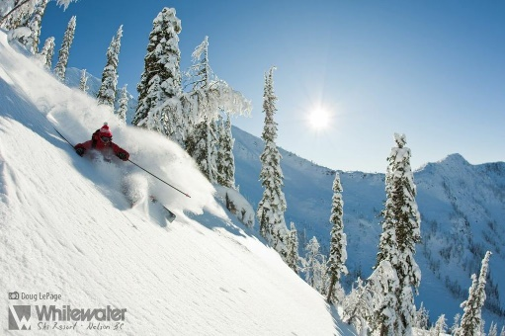
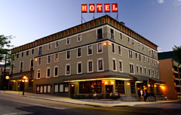
Key Employers in Nelson and Area
Nelson continues to outpace similar sized jurisdictions with more than1300 business licenses issued in 2018, generating more than $180,000 in license revenue annually & approximately 25% of all taxation
Martin Hotel Group
Whitewater Resort
Nelson Cares
Save on Foods
Selkirk Paving Ltd
Kootenay Co-Op
Selkirk College
RDCK
City of Nelson
Maglio Building
School District 8
Kootenay Lake Hospital

Slide 3
The NAEDP partnership is an arrangement where parties agree to cooperate to advance their mutual interests toward economic development
The NAEDP partnership formed in 2005
Chamber of Commerce
City of Nelson
Community Futures
Expanded partnership in 2010
RDCK Areas E & F
Chamber of Commerce
Community Futures
City of Nelson
& RDCK

Slide 4
NAEDP Coordinating Committee
City of Nelson
City Councillor – Rik Logtenberg
CAO - Kevin Cormack
RDCK Areas E and F
Ramona Faust, Area E
Tom Newell, Area F
Community Futures
Executive Director - Andrea Wilkey
Past Chair - Bob Wright
Nelson Chamber
Executive Director - Tom Thomson
Director - Tanya Finley

Slide 5
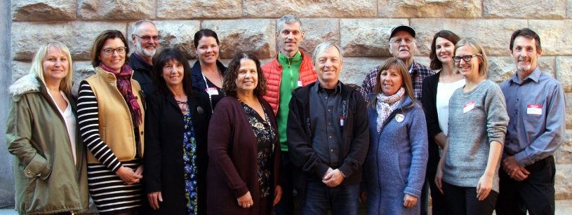
NAEDP Advisory Committee
City of Nelson – Keith Page, Rik Logtenberg, Mayor John Dooley
RDCK Areas E & F - Tom Newell, Ramona Faust, Stuart Horn, Gary McCandlish
Community Futures - Andrea Wilkey, Bob Wright
Nelson Chamber - Tom Thomson, Tanya Finley, Bob Hall
Members at Large: Ari Derfel (Kootenay Coop), Doug Mann (Pacific Insight), David Harasym (DHC Communications), Randy Horswill (Home Hardware), Jocelyn Carver (Kootenay Career Development), Dianna Ducs (Kootenay Lake Tourism), Cameron Whitehead (Kootenay Association of Science and Technology)

Slide 6
2018 – 2020 Strategic Priorities

Slide 7
Strategic Priorities 2018-20
Business Retention & Expansion
Create a Nelson & Area Community Investment Fund
Support for local businesses to adopt technology
Build on Shop Local-Buy Local strategy
Building our Digital Economy
Technology Adoption
Nelson Innovation Centre
Digital Literacy
Workforce
Alignment of education and workforce needs
Promote local career paths
Housing
Work with developers, businesses and local government in developing rental housing strategies and solutions

Slide 8
2018-20 Advocacy Areas
Transportation
Social development, including poverty reduction
Downtown
Transitioning cannabis sector to legal market

Slide 9
2018/19 Key Achievements

Slide 10
Strategic Goals & Actions
ACTIONS
Create a Nelson & Area Community Investment Fund
Provide ongoing training and support re: tech adoption by local business
Goal 1: Business Retention & Expansion
To be leaders in maintaining and growing the number of businesses in Nelson and Area, and addressing barriers to expansion. To create a climate for sustainable growth in terms of the number of businesses in Nelson & Area, and number of employees per business.

Slide 11
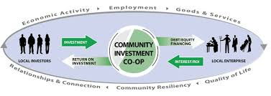
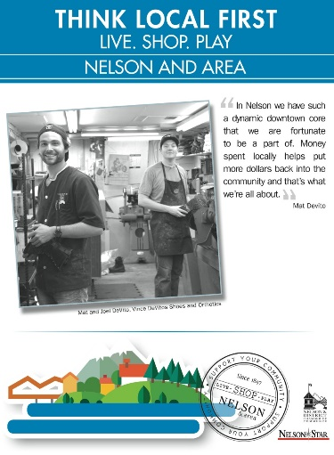
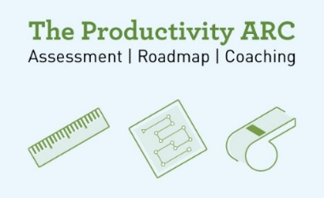
Achievements & Progress Report
Goal 1. Business Retention & Expansion
West Kootenay Community Investment Coop incorporated
CF Training Center offering technology specific training
BBA adding Tech Adoption support
Local manufacturers accessing productivity ARC assessments
Think Local-Buy Local First Marketing Campaign
Metrics:
1,348 business licenses
$9.54 business property tax rate

Slide 12
Strategic Goals & Actions
ACTIONS
Nelson Innovation Centre launched by 2020
Improve digital equality of organizations + citizens.
Improve digital literacy of 100 residents per year.
Market Nelson & Area as a rural tech hub and communicate our story to the world.
Goal 2: Building our Digital Economy
Lead Nelson & Area to strengthen our digital economy and be recognized as one of the Top 7 by the Intelligent Community Forum by 2020.

Slide 13
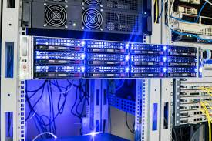
Achievements & Progress Report
Goal 2. Building our Digital Economy
Traction on Demand establishing a Nelson location
Digital equality project w/ Library & Youth Center
Broadband expansion/CoLo upgrade
BC Smart Cities Regional Finalist $40,000
Metrics:
750+ Nelson Tech & Knowledge Workers
95 Ladies Learning Code participants
73 buildings connected to Nelson fibre

Slide 14
Strategic Goals & Actions
ACTIONS
Liaison with school district + Selkirk College to understand skills training curriculum.
Understand current labour pool’s demographics and barriers to engagement in the workforce.
Host a Career Day or promote “100 Mile Career Path” to promote education and career paths in the region.
Goal 3: Workforce
Lead residents to discover career paths that can retain them and support employers to attract and retain staff that meet their needs.

Slide 15
Achievements & Progress Report
Goal 3. Workforce
Hosted roundtable discussions with School District & Selkirk College to discuss alignment of training with business needs
100 Mile Career Path video concept identified
Hosted workshop with Industry Training Authority, Selkirk College, School District 8 and Industry promoting Trades
Building on the Manufacturing Labour Market Project, a follow up LMP is being pursued to provide additional business supports
2000+ jobs searched for Nelson through Imagine Kootenay YTD
Metrics:
1,172 employment opportunities advertised
3.3% population growth
Current population 10,572

Slide 16
Strategic Goals & Actions
ACTIONS
Work with developers, businesses and local govt in developing rental housing.
Identify barriers and incentives for builders.
Goal 4: Housing
A variety of housing options is available for the workforce. Support the creation of short-term and long-term solutions and lead where needed.

Slide 17
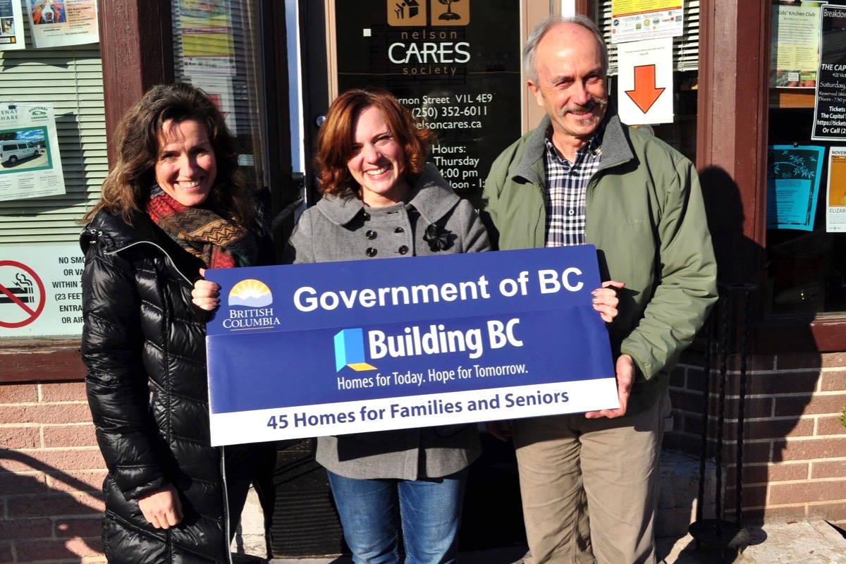
Achievements & Progress Report
Goal 4. Housing
Advocacy and support for affordable, low cost and seniors housing development projects
Chamber Sector consultation with Builders-Developers on housing and development issues and opportunities
Policy – Laneway Housing/STR/update Housing Strategy
Projects:
Railtown: Rezoned Maglio Lands – Mixed use
Private developments: 611 Vernon (125 assisted care); 205 Hall Street (42)
Non-profit projects: NelsonCares (47); SHARE (39)
Metrics:
$43 Million in building permit values
321 building permits issued
121 new housing starts (2018) over 200 units approved projected to start in 2019 (Nelson only)

Slide 18
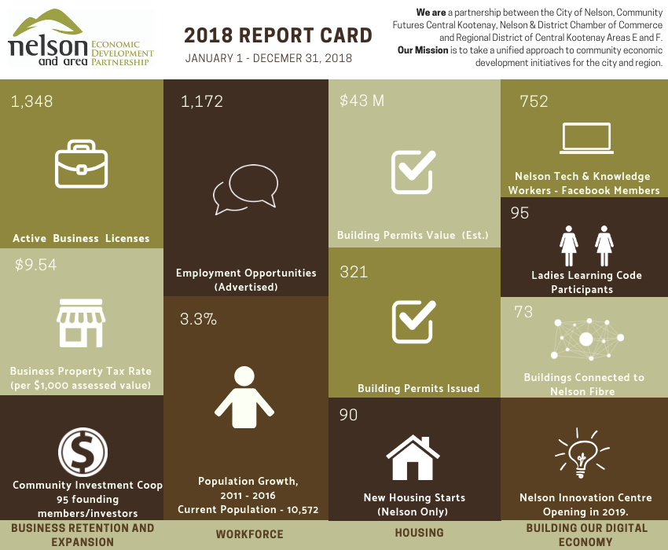

Slide 19
2019/20 Priorities

Slide 20
Strategic Priorities 2019/20
Goal 1: Business Retention & Expansion
Business continuity plans in place in the case of a natural disaster.
Increase available workforce housing
Support the implementation of the West Kootenay Community Investment Fund
Training for local businesses to adopt technology
Sector consultations
Buy Local-Shop Local

Slide 21
Strategic Priorities 2019/20
Goal 2: Building Our Digital Economy
Intelligent Community Forum application for 2020
Liaise with technology companies to attract and support transition to Nelson
Nelson Innovation Centre launched by 2020.
Improve digital equality of organizations and citizens in Nelson & Area
Support regional Smart Communities transportation solution
Market Nelson & area as a rural technology hub

Slide 22
Strategic Priorities 2019/20
Goal 3: Workforce
Advocacy/facilitation role between employers and post-secondary.
Understand workforce needs and current labour pool’s demographics and barriers to engagement in the workforce.
Promote “100 Mile Career Path” via video series.
Advocacy Areas:
Transportation including regional airport, public transit, housing needs, climate change impacts and other transportation-related barriers to community economic development;
Social development including poverty reduction;
Downtown & Railtown development; and
Transition of cannabis sector to the legal economy

Slide 23
Investment & Workforce Attraction

Slide 24
Program Goals:
1. Raise the profile of the Kootenays
2. Connect investors with Kootenay opportunities and stimulate expanded Kootenay investment
3. Attract a diverse workforce to the region
4. Achieve the long-term sustainability of the partnership

Slide 25
Performance Highlights
2018-19 YTD*
Website visits: 66,000
Job search/month: 950
Verified sales: 7 Tracked transactions: 37
Direct inquiries: 400+
*April 2018 – December 2018

Slide 26
Key motivations for Imagine Kootenay
Kootenays have the highest median age (47) of all of BC’s economic regions.
Kootenays need 22,900 new employees by 2025 just to replace retiring workers, and 30,000 are needed to ensure modest economic growth. (Work BC, 2018 Labour Market Outlook)
2017 Nelson & Area BRE Survey found 41% of businesses currently face recruitment challenges.
35% of people moving to non-urban areas of BC are ages 25-44.
Awareness of the Kootenays is surprisingly low among residents of BC, Alberta and Washington State. (Destination BC Research)

Slide 27
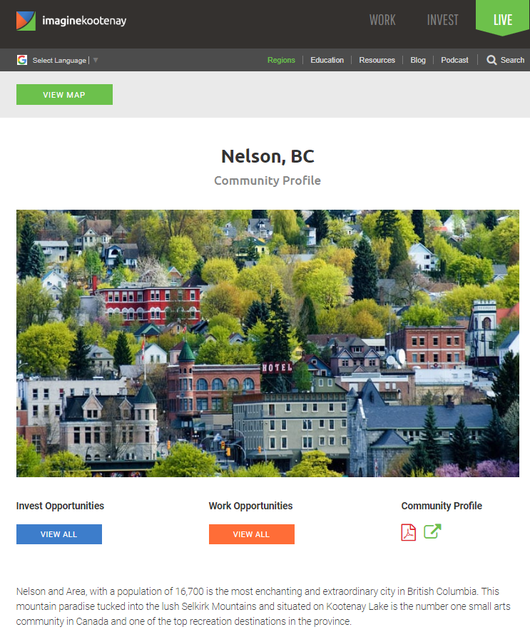
Community Specific Content
Business investment opportunities
Job search feed
Business success stories
Employer profiles
Blog stories
Nelson Performance Highlights
35 new opportunities posted
125+ direct inquires
5 opportunities sold ($3.1 million)
2,000 job search queries
29,000 page views
*April 2018 – December 2018

Slide 28
The NAEDP MOU states: the City of Nelson & RDCK Areas E & F provide core funding to the NAEDP. The NAEDP is recommending that the partnership maintain consistent funding. As such for fiscal year 2019/20 the NAEDP recommends an $80,000 allocation.

